Slide 1
FLOWCHART

Slide 2
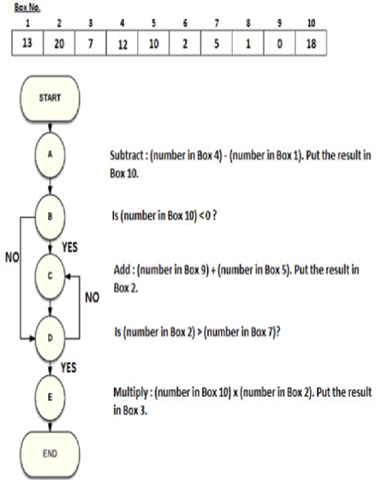

Slide 3
Q. 1 At the end of the flowchart, what will be the number stored in Box 4?
Q. 2 At the end of the flowchart, what will be the number stored in Box 3?
Q. 3 At the end of the flowchart, the number in all of the following boxes will change; except:

Slide 4
Q. 1 At the end of the flowchart, what will be the number stored in Box 4? ANSWER : 12
Q. 2 At the end of the flowchart, what will be the number stored in Box 3?
ANSWER : -10
Q. 3 At the end of the flowchart, the number in all of the following boxes will change; except:
ANSWER : 1

Slide 5
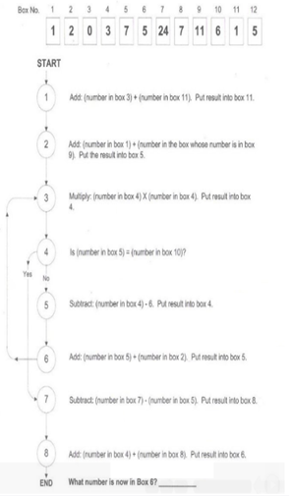

Slide 6
Q 1. what number is now in box 6?
24
25
26
27

Slide 7
Q 1. what number is now in box 6?
24
25
26
27

Slide 8
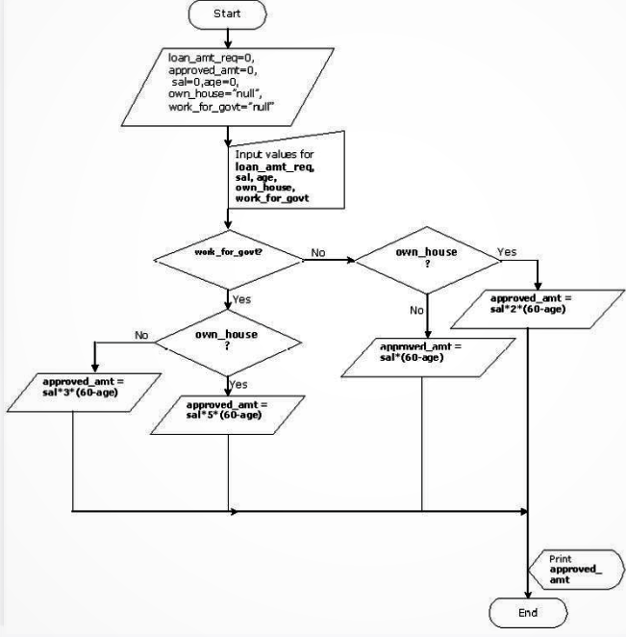

Slide 9
Q 1. For an individual who works for a government organization and owns a house. It is given that he is 35 years old and earns Rs. 15000 per month. What would the approved_amt for him
1875000
1975000
1825000
2075000

Slide 10
Q 1. For an individual who works for a government organization and owns a house. It is given that he is 35 years old and earns Rs. 15000 per month. What would the approved_amt for him
1875000
1975000
1825000
2075000

Slide 11
Q 2. A person wishes to avail a loan of Rs. 5000000. He works for a government organiations and does not own a house. Would he get the loan if he draw a salary of Rs. 60000 and his age is 28 years. If he does get a loan what amount would he be entitled? If not by what amount he would be shor of the required amount?
Yes he would get a loan equal to Rs 5000000
Yes, he would get a loan equal to Rs 5760000
No, he would not get a loan he would be short of Rs 70000
No, he would not get a loan he would be short of Rs. 760000

Slide 12
Q 2. A person wishes to avail a loan of Rs. 5000000. He works for a government organiations and does not own a house. Would he get the loan if he draw a salary of Rs. 60000 and his age is 28 years. If he does get a loan what amount would he be entitled? If not by what amount he would be shor of the required amount?
Yes he would get a loan equal to Rs 5000000
Yes, he would get a loan equal to Rs 5760000
No, he would not get a loan he would be short of Rs 70000
No, he would not get a loan he would be short of Rs. 760000

Slide 13
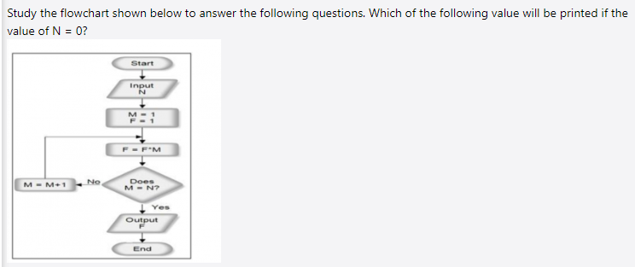

Slide 14
Q 1. which of the following value will be printed if N=0?
ZERO
720
5040
NONE OF THESE

Slide 15
Q 1. which of the following value will be printed if N=0?
ZERO
720
5040
NONE OF THESE

Slide 16
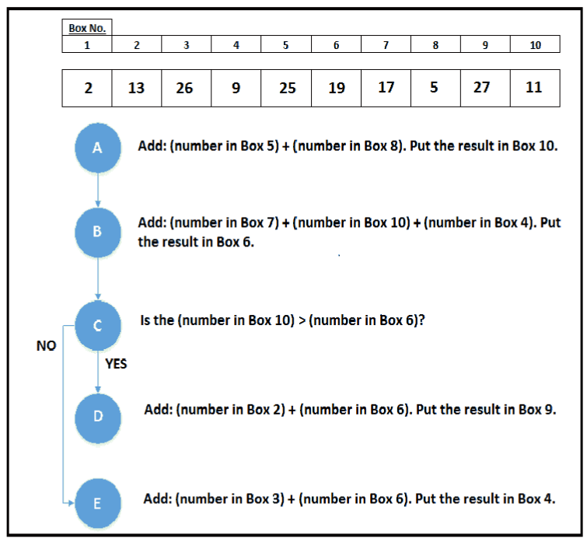

Slide 17
Q1. At the end of the flow chart, what is the number stored in the Box 9?
Q2. At the end of the flow chart, what is the value of number stored in the box whose number is stored in Box 8?
Q3. At the end of the flowchart, determine the value of the following expression. (Number in Box 1) x (Number in Box 4) - (Number in Box 6) - (Number in Box 10)

Slide 18
Q1. At the end of the flow chart, what is the number stored in the Box 9?
ANSWER : 27 Q2. At the end of the flow chart, what is the value of number stored in the box whose number is stored in Box 8?
ANSWER : 25
Q3. At the end of the flowchart, determine the value of the following expression. (Number in Box 1) x (Number in Box 4) - (Number in Box 6) - (Number in Box 10)
ANSWER : 78

Slide 19
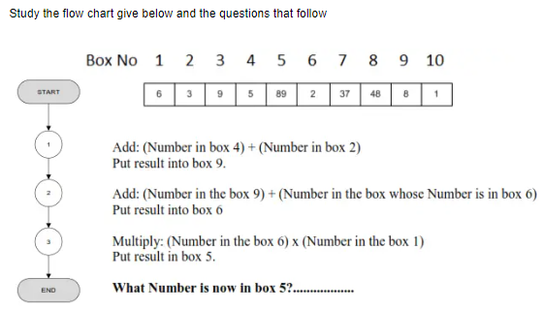

Slide 20
Q 1. What number is now in box 5?
66
56
65
None of these

Slide 21
Q 1. What number is now in box 5?
66
56
65
None of these

Slide 22
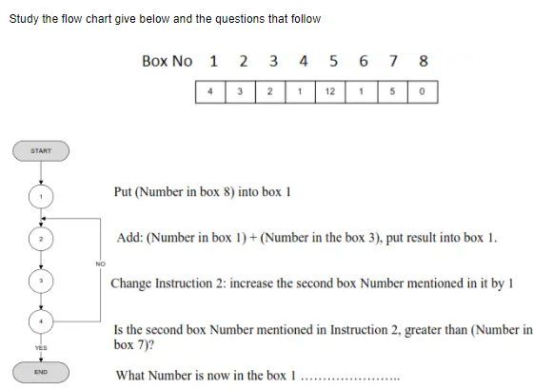

Slide 23
Q 1. What number is now in box 1?
32
15
14
NONE

Slide 24
Q 1. What number is now in box 1?
32
15
14
NONE

Slide 25
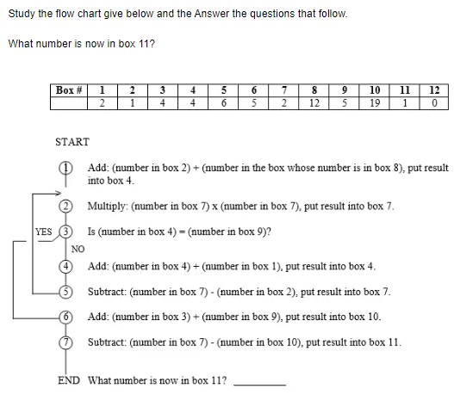

Slide 26
Q 11. What number is now in box 1?
55
15
58
NONE

Slide 27
Q 11. What number is now in box 1?
55
15
58
NONE

Slide 28
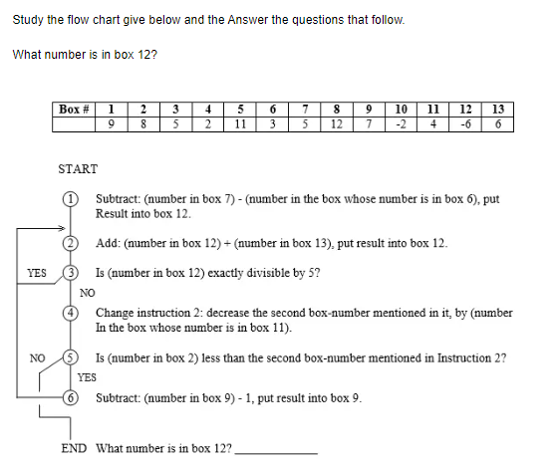

Slide 29
Q 1. What number is now in box 12?
12
19
58
NONE

Slide 30
Q 1. What number is now in box 12?
12
19
58
NONE

Slide 31
THANK YOU

